Slide 1
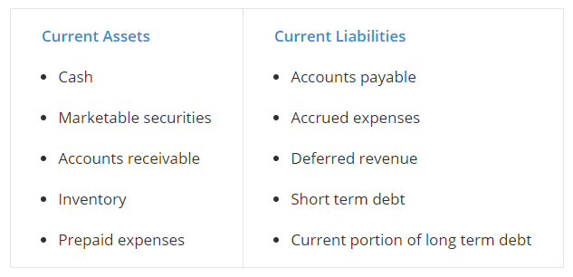
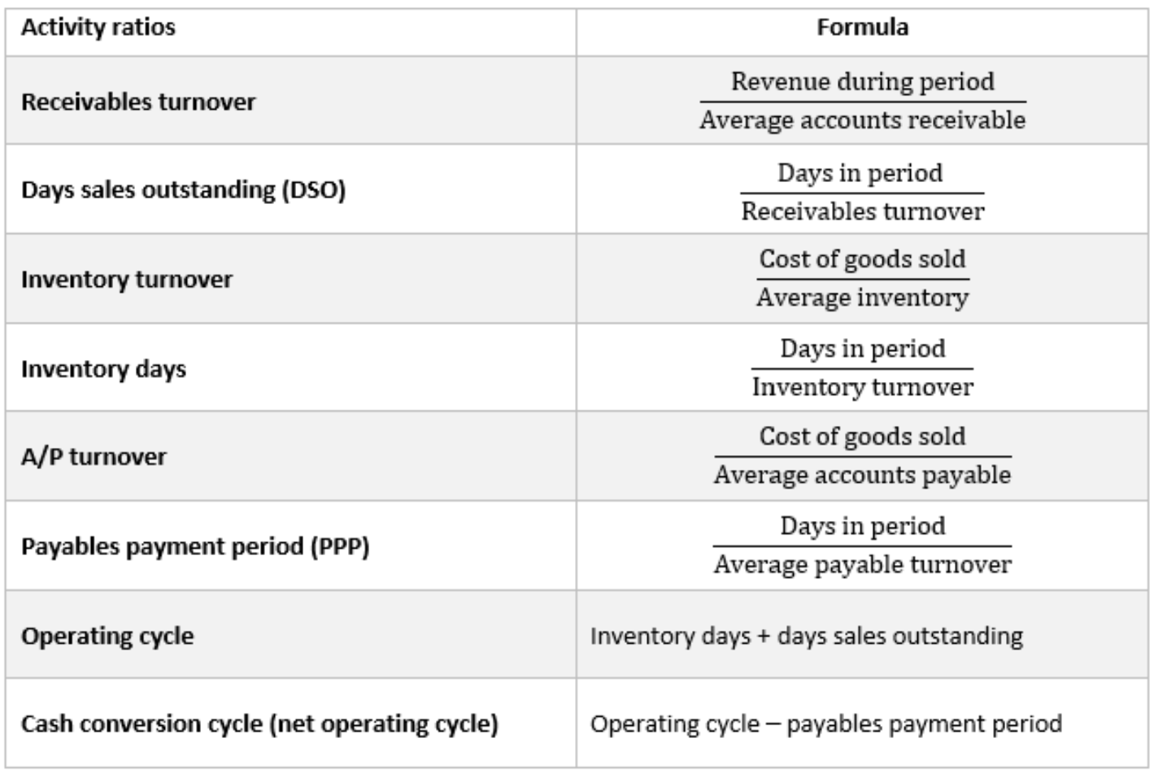

Cash, accounts receivable, inventories and accounts payable are often discussed together because they represent the moving parts involved in a company’s operating cycle (a fancy term that describes the time it takes, from start to finish, of buying or producing inventory, selling it, and collecting cash for it). Conceptually, the operating cycle is the amount of days that it takes between when a company initially puts up cash to get (or make) stuff and getting the cash back out after you sold the stuff.
Since companies often purchase inventory on credit, a related concept is net operating cycle (or cash conversion cycle), which factors in credit purchases. In our example, if the retailer purchased the inventory on credit with 30-day terms, it had to put up the cash 33 days before it collected. Here, the cash conversion cycle is 35 days + 28 days – 30 days = 33 days. Pretty straightforward.
$$Working capital=Current assets −Current liabilities$$
$$Current ratio= \frac{Current asset}{Current liabilities}$$
$$Quick ratio= \frac{Cash and marketable securities and accounts receivable}{Current liabilities}$$
The balance sheet organizes assets and liabilities in order of liquidity and this makes assessing working capital straightforward.
The cash flow statement organizes items categorically – operating, investing, and financing.
Current assets on the balance sheet are commonly tied to operating cash flow impacts (embedded within changes in operating assets and liabilities).

Slide 2
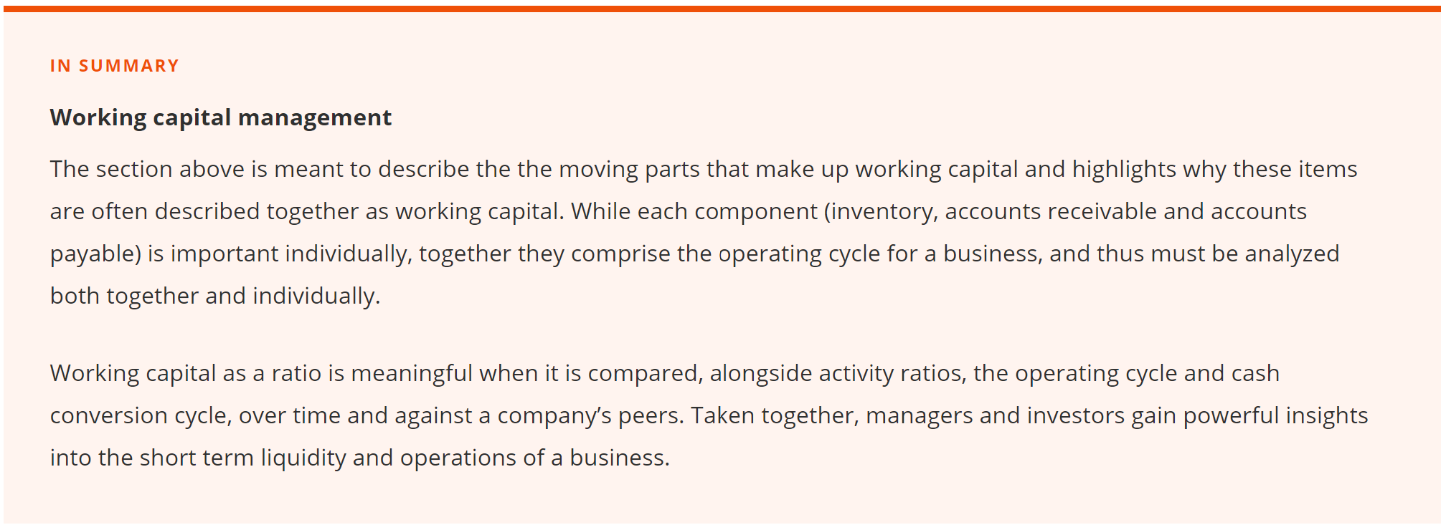
Working capital management
For many firms, the analysis and management of the operating cycle is the key to healthy operations.
For example, imagine the appliance retailer ordered too much inventory – its cash will be tied up and unavailable for spending on other things (such as fixed assets and salaries). Moreover, it will need larger warehouses, will have to pay for unnecessary storage, and will have no space to house other inventory.
Imagine that in addition to buying too much inventory, the retailer is lenient with payment terms to its own customers (perhaps to stand out from the competition). This extends the amount of time cash is tied up and adds a layer of uncertainty and risk around collection.
Now imagine our appliance retailer mitigates these issues by paying for the inventory on credit (often necessary as the retailer only gets cash once it sells the inventory). Cash is no longer tied up, but effective working capital management is even more important since the retailer may be forced to discount more aggressively (lowering margins or even taking a loss) to move inventory in order to meet vendor payments and escape facing penalties.
Taken together, this process represents the operating cycle (also called the cash conversion cycle). Companies with significant working capital considerations must carefully and actively manage working capital to avoid inefficiencies and possible liquidity problems. In our example, a perfect storm could look like this:
Retailer bought a lot of inventory on credit with short repayment terms
Economy is slow, customers aren’t paying as fast as was expected
Demand for the retailer's product offerings change and some inventory flies off the shelves while other inventory isn't selling
In this perfect storm, the retailer doesn’t have the funds to replenish the inventory that’s flying off the shelves because it hasn’t collected enough cash from customers. The suppliers, who haven’t yet been paid, are unwilling to provide additional credit, or demand even less favorable terms. In this case, the retailer may draw on their revolver, tap other debt, or even be forced to liquidate assets.
The risk is that when working capital is sufficiently mismanaged, seeking last-minute sources of liquidity may be costly, deleterious to the business, or in the worst-case scenario, undoable.

